Slide 1
MULTI-CUT REBAR
Advisor : Prof. K.C.Chang
Presenters : You-Ran Nai

Slide 2
RIGOROUS
PROCEDURE
2
3
ETABS9
PYTHON
ETABS2016/SAP
MATLAB
IDA
ETABS DEMAND
MULTI-CUT
NONLINEAR HISTORY ANALYSIS
LINEAR
NON-LINEAR
1
4
EXCEL
VBA
ETABS9
PYTHON
MPA
MMC
APA
FROM EXISTING REBAR
MULTI-MODES PUSHOVER
ENGINEER
SIMPLICITY

Slide 3
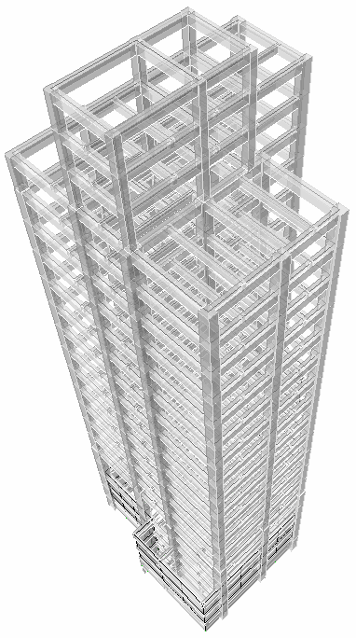
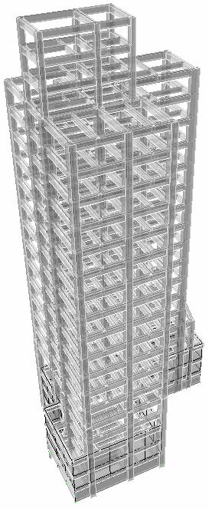
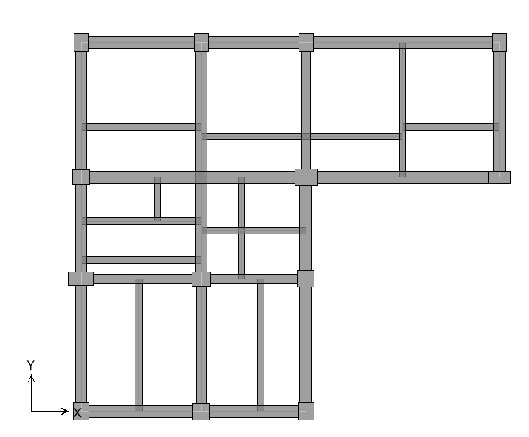

Slide 4
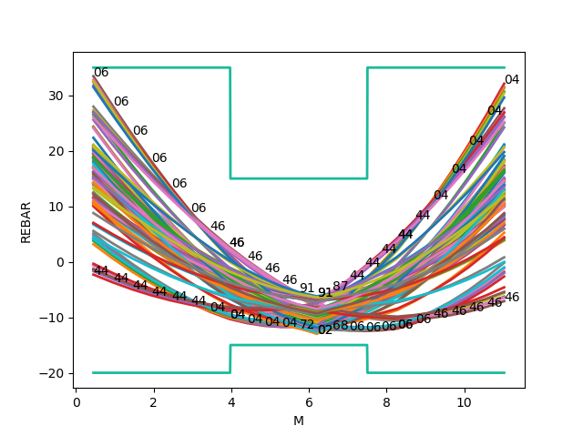
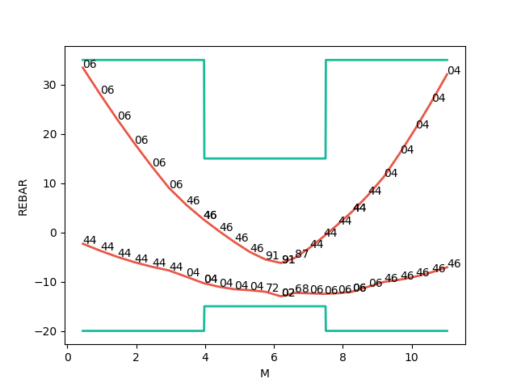

Slide 5
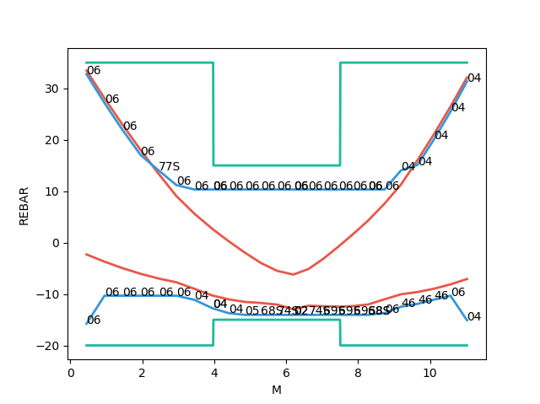

Slide 6
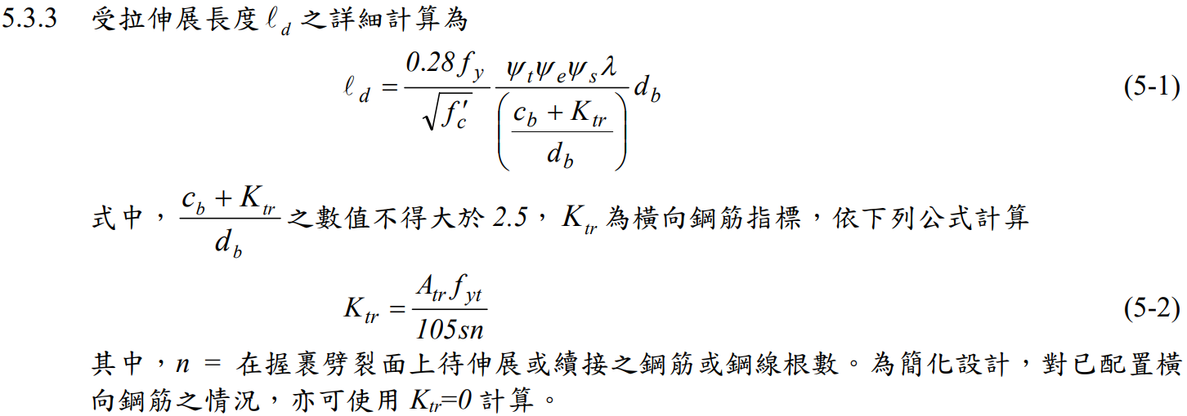
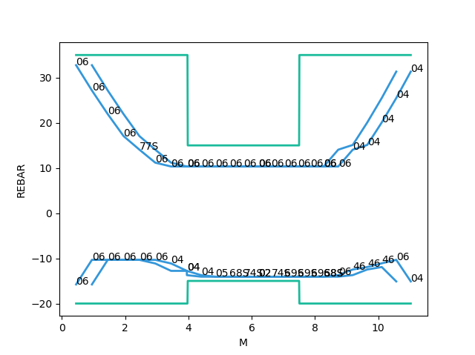
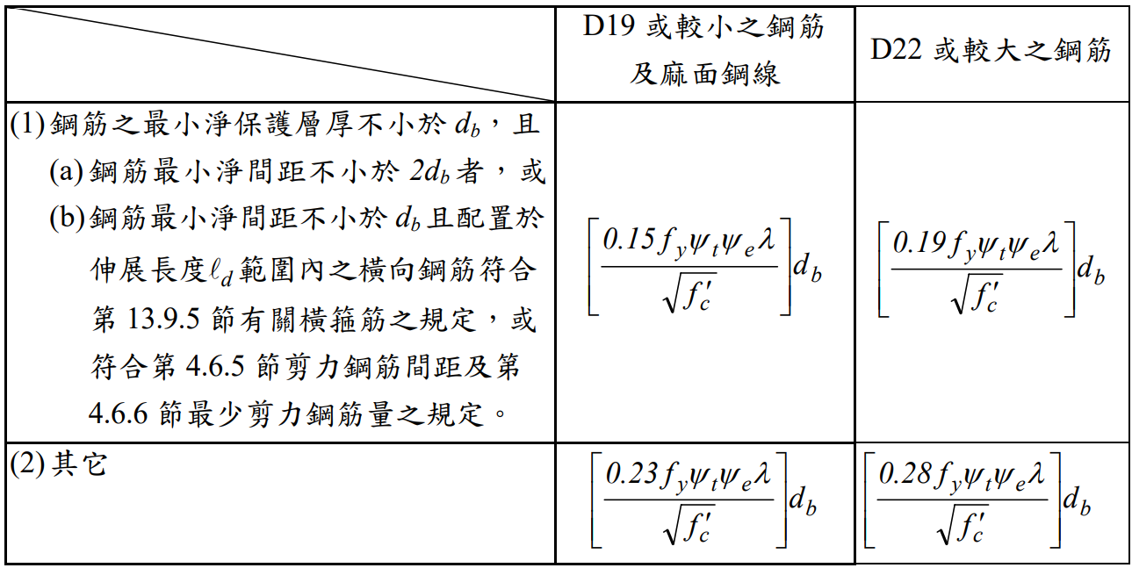
GENERAL DEVELOPMENT LENGTH EQUATION
DEVELOPMENT LENGTH
MIN
➔
SIMPLIFIED PROVISIONS
Beam width, cover, Fy, Fyt, Fc’,
Rebar‘s Db, Stirrup’s Db,
Spacing, rebar number

Slide 8
A modal pushover analysis procedure to estimate seismic demands for unsymmetric-plan buildings
Anil K. Chopra and Rakesh K. Goel
EARTHQUAKE ENGINEERING AND STRUCTURAL DYNAMICS
November 2003

Slide 9
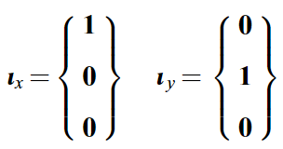

EQUATIONS OF MOTION

Slide 10
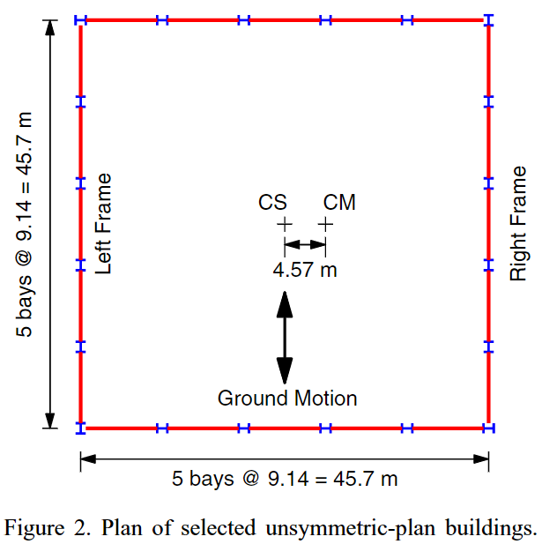
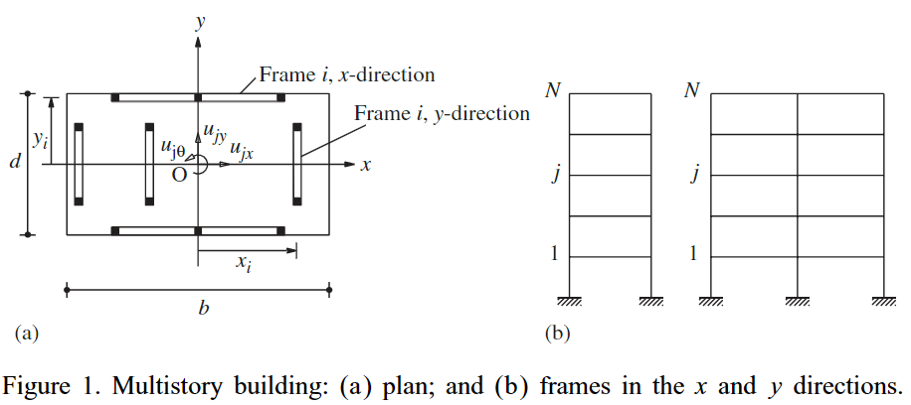
SELECTED BUILDINGS

Slide 11
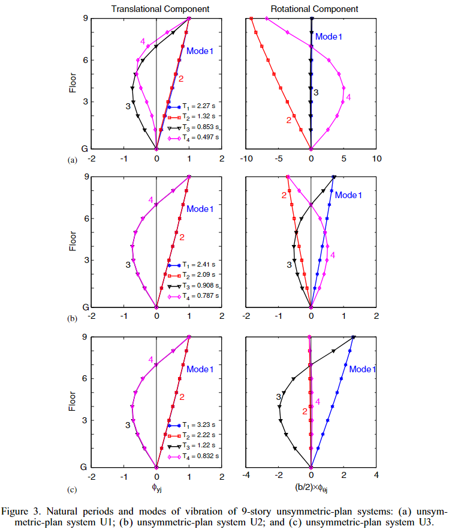




TORSIONALLY-STIFF
$$I_{Oj}/m$$
LATERAL > TORSIONAL
TORSIONALLY-SIMILARLY-STIFF
FIRST TWO MODES CLOSE
$I_{Oj}/m$ = 2.95
LATERAL $≅$ TORSIONAL
TORSIONALLY-FLEXIBLE
$I_{Oj}/m$ = 6
LATERAL < TORSIONAL

Slide 12
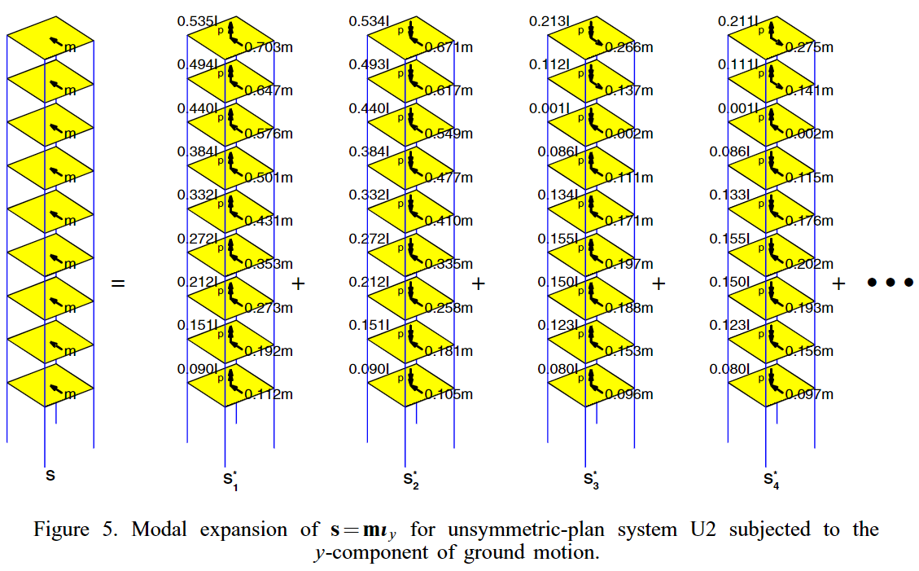



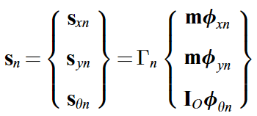
MODAL EXPANSION OF EFFECTIVE FORCES

Slide 13
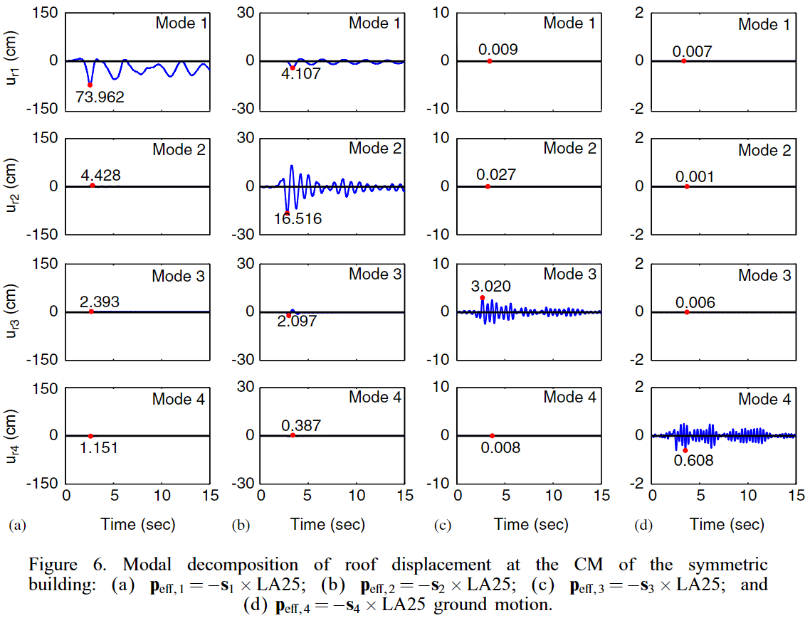
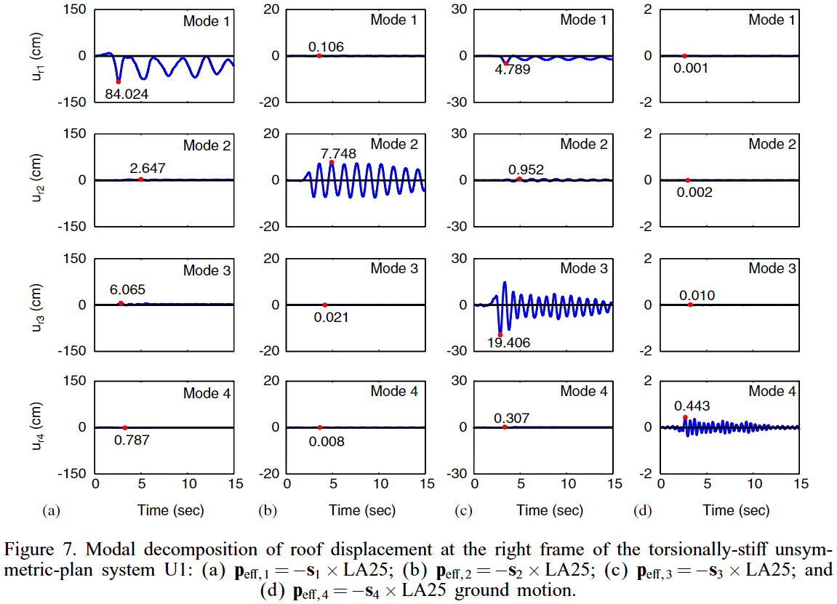


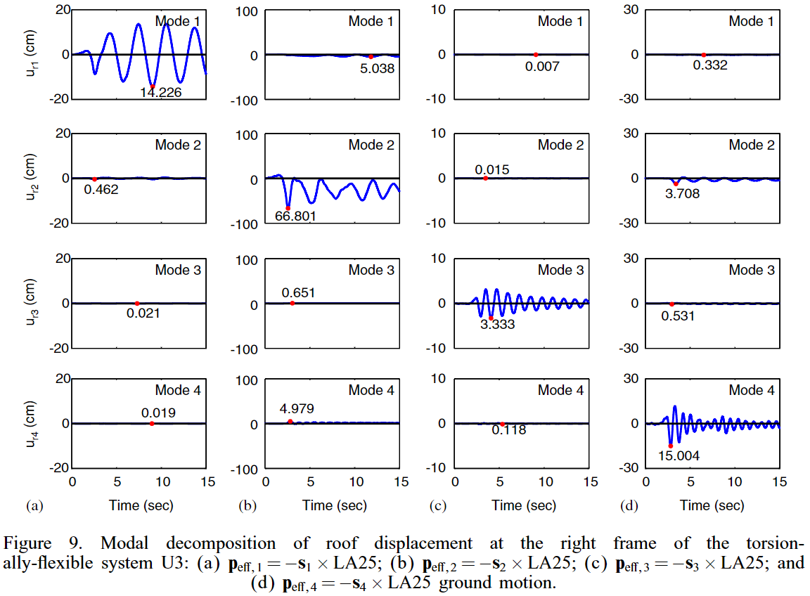
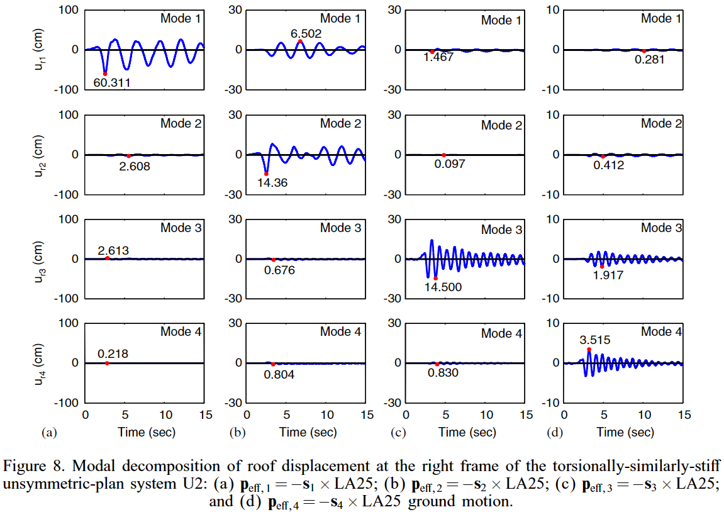
SYMMETRIC
TORSIONALLY-STIFF
TORSIONALLY-FLEXIBLE
TORSIONALLY-SIMILARLY-STIFF

Slide 14
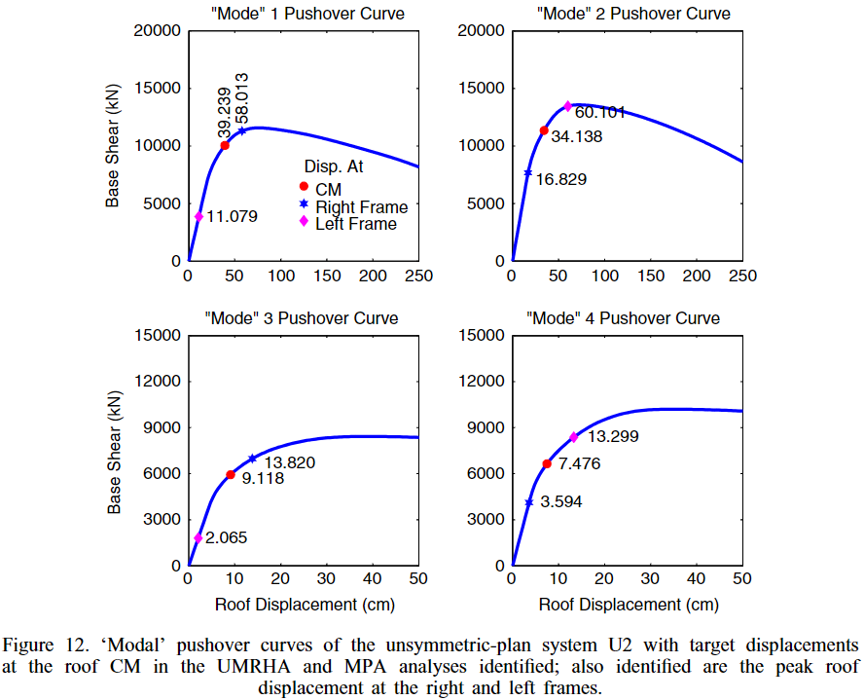
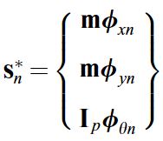
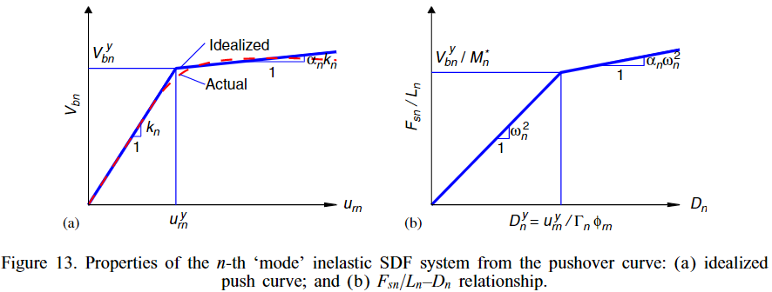
MPA
MODAL FORCE DISTRIBUTION
MODAL COMBINATION RULE
CQC

Slide 15
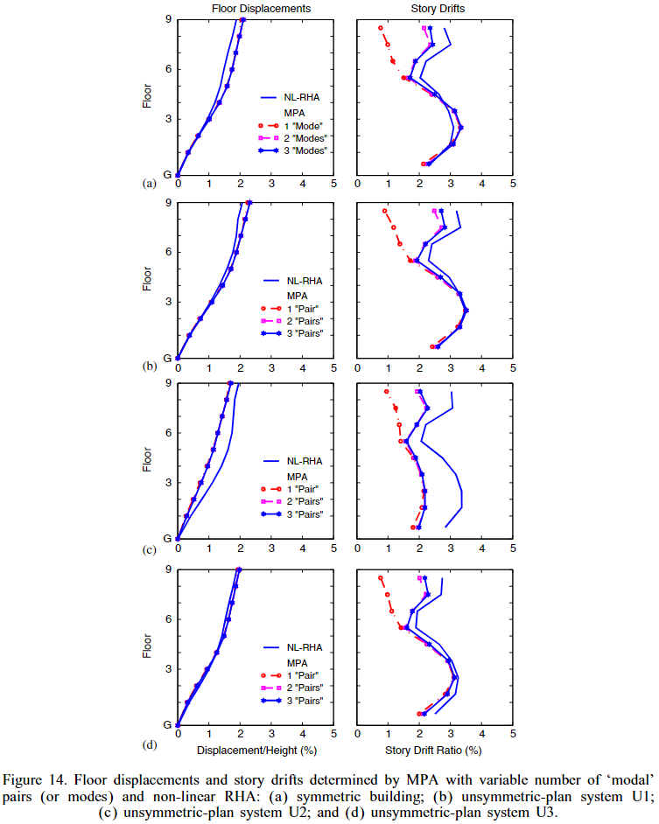
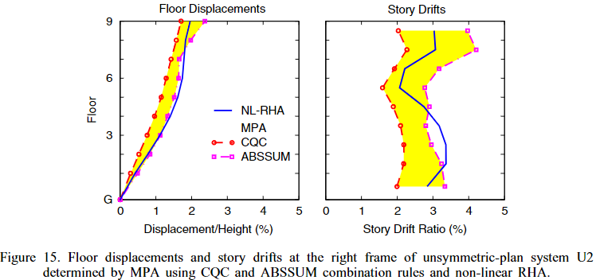
CQC UNDER-ESTIMATION

Slide 16
Punchline of your project in a few words
Here is the subline, explain your project in 2-3 lines so that we clearly understand the value proposal.

Slide 17
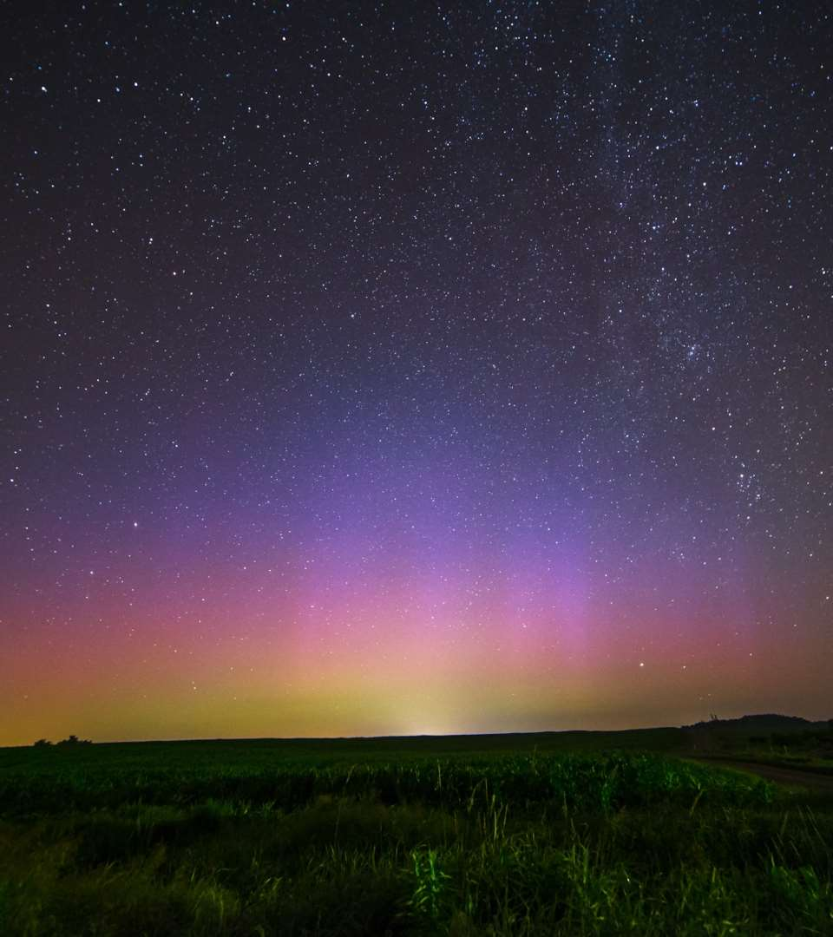
The problem you want to solve

Slide 18
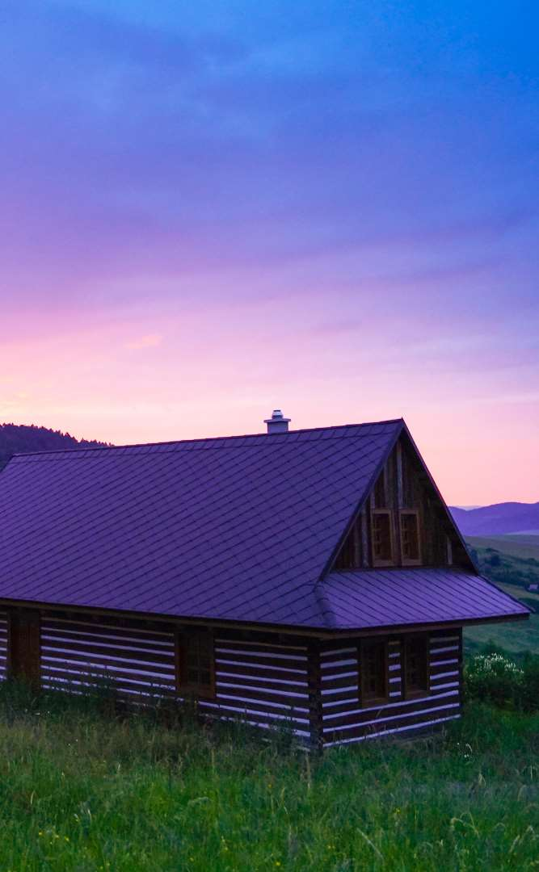


Today’s solutions

Slide 19
Why it doesn’t work
Difficult to implement
Expensive for small businesses
Zero customization

Slide 20

Your solution

Slide 22
Your solution

Slide 23
Your solution

Slide 24
Your solution

Slide 26
Your solution

Slide 27
Awesome features
Awesome map feature
Awesome like feature
Awesome battery feature

Slide 28
Use case
1
2
3
4
5
Very Easy Step 1
Very Easy Step 2
Very Easy Step 3
Very Easy Step 4
Very Easy Step 5

Slide 29
Use case
1
2
3
4
Very Easy Step 1
Very Easy Step 2
Very Easy Step 3
Very Easy Step 4

Slide 30
Value Proposal
Make things really change
Make the world a better place
Offer one perfect answer
This is how we are going to make this happen in a beautiful way.
This is how we are going to make this happen in a beautiful way.
This is how we are going to make this happen in a beautiful way.

Slide 31
Market Sizing
$36b
$12b
$2b
Total World Market
Total US Market
Total FR Market
Source : source.io
Source : source.io
Source : source.io

Slide 32
Market Size over Time
Market Sizing (in €billions)

Slide 33
Market on Map
$1b
$2b

Slide 34
Why Now ?
Mobile Internet Usage

Slide 35


Customer Profiles
Young adults
25-35 years old
Students
15-20 years old

Slide 36
Competitors

Slide 37
AXIS 2
Your company
competitor
competitor
AXIS 1
AXIS 1
competitor
competitor
competitor
competitor
AXIS 2

Slide 38
 | YOUR COMPANY | COMPETITOR 1 | COMPETITOR 2 | COMPETITOR 3
feature 1
feature 2
feature 3
feature 4
feature 5
feature 6

Slide 39
Metrics
800
97%
94%
Paying users
Margin
Recurring users
$150,000
85,000
54
Monthly Recurring
Revenue
Users growing 45% per month
API Integrations

Slide 40
Conversion Rate
0,27%

Slide 41
Split Budget

Slide 42
Split Budget
75%
69%
30%
29%
29%
Marketing
Research
Sales
Design
Hiring

Slide 43
Forecast

Slide 44
Financial Table
 | 2016 | 2017 | 2018 | 2019 | 2020
Sales | 0 | 50 | 400 | 1000 | 3000
Revenue | - | $100 000 | $800 000 | $2 000 000 | $6 000 000
Gross Margin (%) | - | 49% | 51% | 53% | 58%
Expenses | - | $128 000 | $450 000 | $800 000 | $1 200 000
Net Profit | - | $-28,000 | $350 000 | $1 200 000 | $4 800 000
Profit Margin (%) | - | -28% | 44% | 60% | 80%

Slide 45
Outstanding Founders
Dave Lopper CTO
Come Mertial CEO
Tran Zition
CPO
Google
Facebook
Stanford
Microsoft
SalesForce
HEC Paris
Uber
Awwwards
MIT Media Lab

Slide 46
Advisors and Directors
Jérémy Vestiaire
Financial Advisor
Goldman Sachs
Jey Bestelgram
Product Advisor
Amazon
Oudam Dadam
Machine Learning Enthousiast
SpaceX
Tomy Lamousse
PR Advisor
Mashable
Lam Ontarelle
UX Contributor
Slidor
Renaude Yorella
Board Member
Sequoia Capital
Laurence Marc
Board Member
Accel Partners
Vince Lacluze
UI Director
Snapchat

Slide 47
Roadmap
02/2016
04/2016
06/2016
Market Overview
Pre-Release
Launch
01/2016
03/2016
05/2016
Introduction
Partnerships
Beta

Slide 48
Say you want to make the world a better place

Slide 49
Icons

Slide 50
Icons

Slide 51
Social

Slide 52
Red
Pink
Purple
Deep Purple
Indigo
Blue
Light Blue
Cyan
Teal
Green
Light Green
Lime
Yellow
Amber
Orange
Deep Orange
50
50
50
50
50
50
50
50
50
50
50
50
50
50
50
50
100
100
100
100
100
100
100
100
100
100
100
100
100
100
100
100
200
200
200
200
200
200
200
200
200
200
200
200
200
200
200
200
300
300
300
300
300
300
300
300
300
300
300
300
300
300
300
300
400
400
400
400
400
400
400
400
400
400
400
400
400
400
400
400
500
500
500
500
500
500
500
500
500
500
500
500
500
500
500
500
600
600
600
600
600
600
600
600
600
600
600
600
600
600
600
600
700
700
700
700
700
700
700
700
700
700
700
700
700
700
700
700
800
800
800
800
800
800
800
800
800
800
800
800
800
800
800
800
900
900
900
900
900
900
900
900
900
900
900
900
900
900
900
900
A100
A100
A100
A100
A100
A100
A100
A100
A100
A100
A100
A100
A100
A100
A100
A100
A200
A200
A200
A200
A200
A200
A200
A200
A200
A200
A200
A200
A200
A200
A200
A200
A400
A400
A400
A400
A400
A400
A400
A400
A400
A400
A400
A400
A400
A400
A400
A400
A700
A700
A700
A700
A700
A700
A700
A700
A700
A700
A700
A700
A700
A700
A700
A700

Slide 53
Gradient 1

Slide 54
Gradient 2

Slide 55
Gradient 3

Slide 56
Gradient 4

Slide 57
Gradient 5

